Slide 1
☕ Web Development with
Lecture 4
PHP & JavaScript
Array & Loop

Slide 2
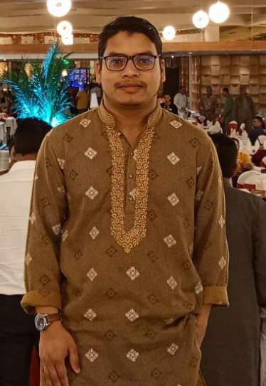
About me
Mohammad Mehedi Hasan
Senior Software Engineer(Team Lead)
ASL Systems Ltd.
PHP, Laravel, CodeIgniter, Yii2
Python, Django, Flask
JavaScript, JQuery, React, Vue
🌐https://mehedih.info/
📱 + 8801738923828
📧 mehedifci907@gmail.com

Slide 3
Objectives
Introduction on Array
Array Initialization
Array Construction
Array Destruction
Types of Array
Insert element into array with built in function and without built in function.
Delete element from array with built in function and without built in function.
Update array element value.
Introduction on Loop
Types of Loop
Syntax of each types of loop
Functions of each types of loop
Array destructing with Loop
Iterating over Multi-dimensional array.
Problem Solving
Right Half Pyramid
Assignment
Find the all of odd number from 1-100.
Factorial number
Fibonacci series
Pattern: Left Half & Full Pyramid,

Slide 4
Let’s Jump to the field

